Slide 1

The Engineering
Design Process

Slide 2
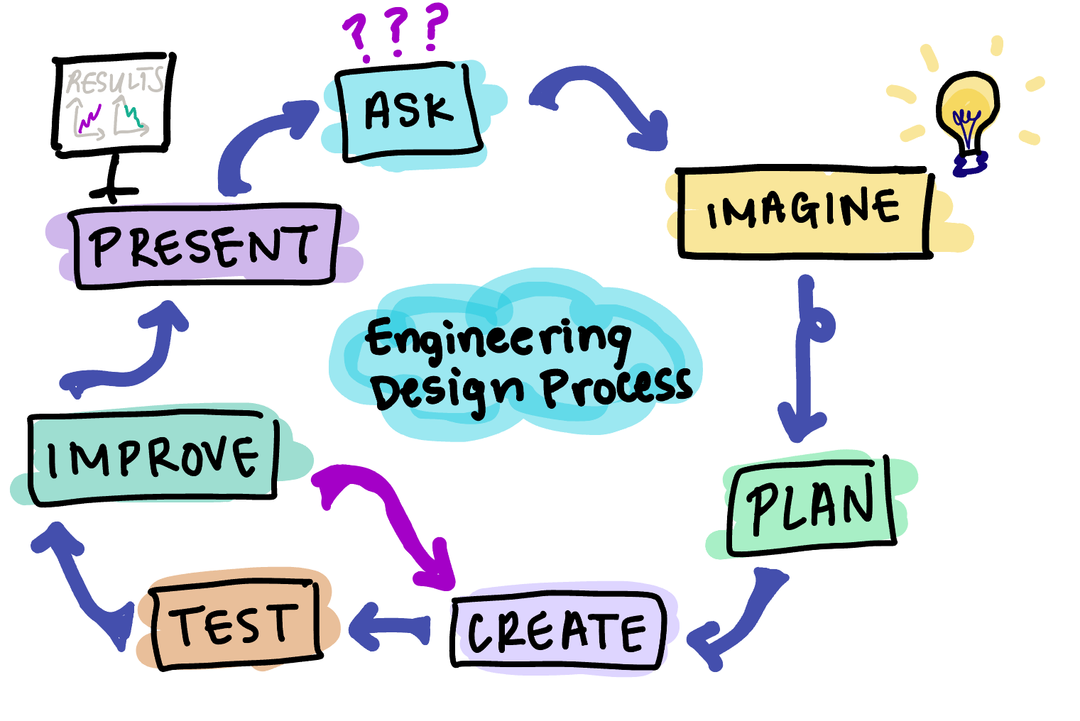

Slide 3
Ask- what’s the problem?
Ana, a camp counselor, needs a way to make snacks personalizable because kids want to stand out and be unique.
Sofia, a student, is worried about the future of the planet and wants recyclable or degradable food packaging for her late night study snacks.

Slide 4
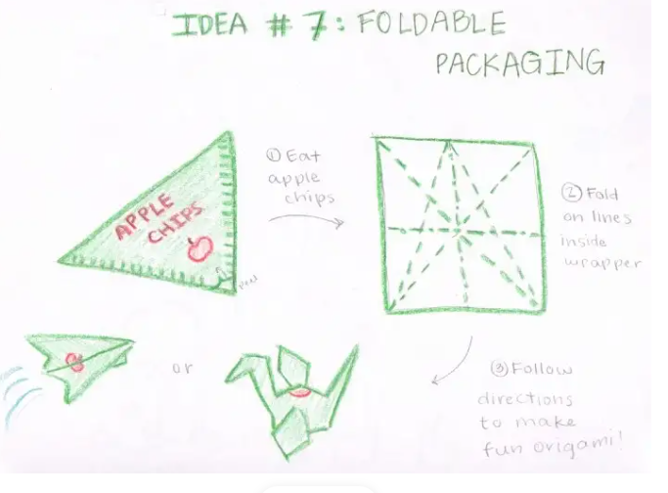
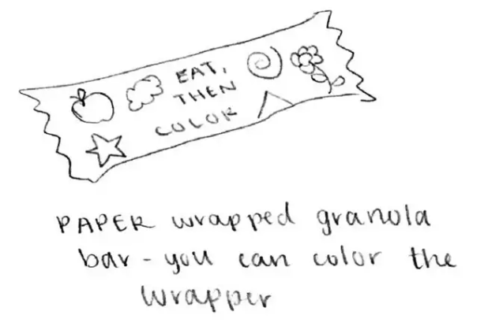
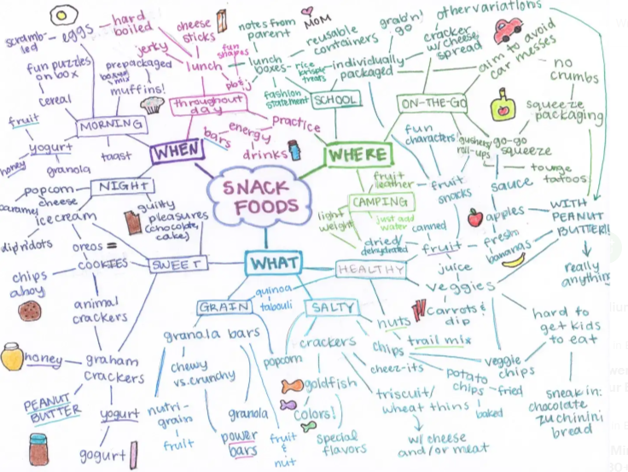
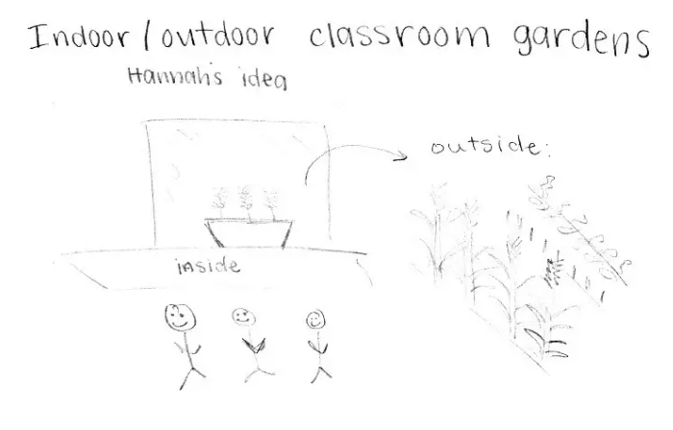
Imagine- generate ideas
Brainstorm!
The
more
Strategies for idea generation include:
Yes and…
Group brainstorm
How might we…
Interview users (also good way to generate needs)
Substitute, combine, modify, adapt, eliminate, rearrange
better
ideas
the

Slide 5
Plan- select a solution
Metrics for selection:
Feasibility
Cost effectiveness
Timeline
Compare to state of the art
Market research
Factors to consider:
Feasibility: technology doesn’t exist (yet)
Sandwich cookie
Cave aged artisan cookie
Gold leaf cookie
x
8-in-1
Flavors Cookie
Zero calorie cookie capsule
x
x
x
Market research: similar product exists
Timeline: too long for production cycle
Cost: too expensive

Slide 6
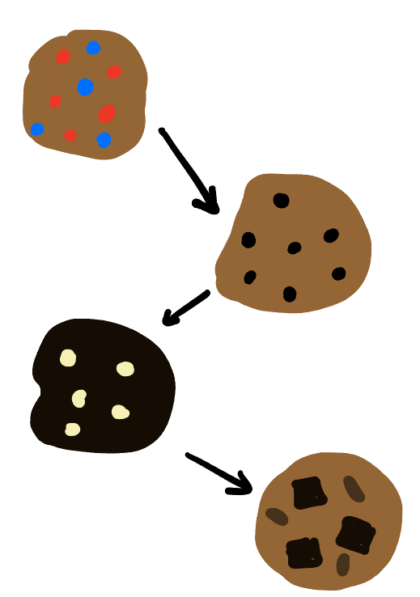
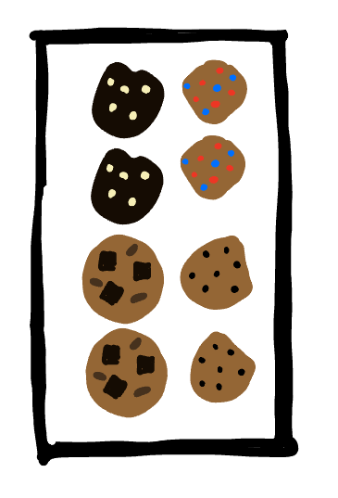
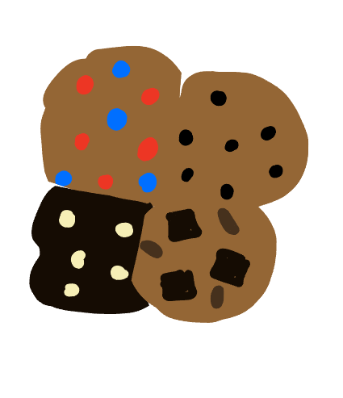
Create- make it!
Rapid prototyping
Proof of concept
Low-cost model

Slide 7
Test- evaluate the solution
Degrades faster, in more mild conditions
50% more lightweight
Keeps food fresh just as long
Kids prefer it to other snacks
Quantitative metrics for success:
Set a benchmark or goal
Is it better than the current state of the art?
Talk to the consumer again!
Sofia: degradable packaging
→ Faster degradation time
→ Milder degradation conditions
→ Keeps food fresh for same amount of time
Ana: unique snacks
→ How many kids prefer the new option?
→ Will parents pay more for it?

Slide 8
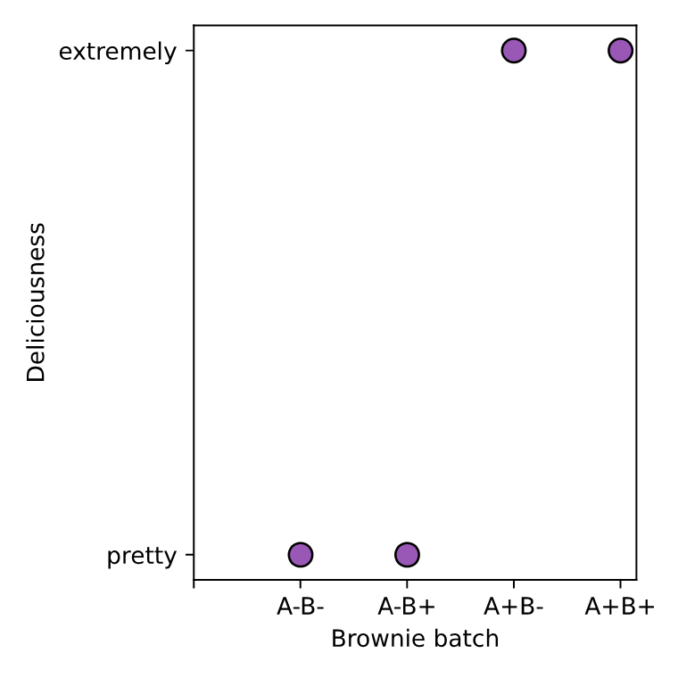
Improve- make changes
Factorial design is a useful framework
Factor | Name | Trial | Treatment
A | Cookie mix-in | - | Plain
 |  | + | Add walnuts
B | Cookie size | - | Normal
 |  | + | Extra large
Clara Troyano-Valls

Slide 9
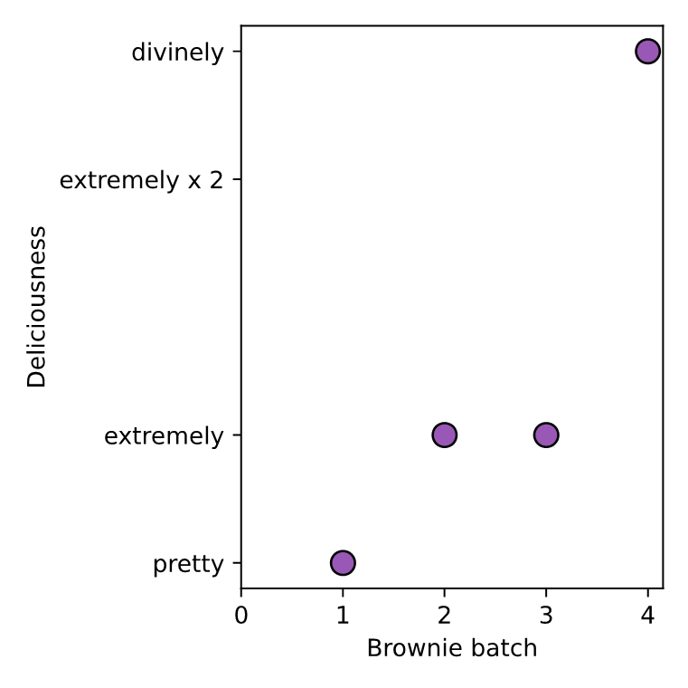
Repeat the create- test- improve cycle until goal is met
Factorial design is a useful framework
Factor | Name | Trial | Treatment
A | Cookie mix-in 1 | - | Plain
 |  | + | Add walnuts
B | Cookie mix-in 2 | - | Normal
 |  | + | Add caramel
Clara Troyano-Valls

Slide 10
Present- share your findings
Present a talk or poster
Patent
Create a company
Write a paper or blog
Find new questions

